Slide 1
Module 07: Abstract Classes & Interfaces
Chapter 13

Slide 2
Motivation
Do you think it is logical to create an object of a class Shape?
Shape
getArea(): double
setColour(int)
Triangle
Circle
Rectangle
Right
Equilateral
What about creating an object of a class Rectangle or Circle?
So why so we need the Shape Class??
Notes:
While it may be useful to discuss Animal in general, in reality an anima must be a cat, dog or a horse.
An abstract class can only be used to derive more specialized classes

Slide 3

Motivation
Do you think it is logical to create an object of a class Tiger or Camel?
Do you think it is logical to create an object of a class animal?
Animal
So why do we need the Animal Class??
Mammals
Birds
Reptiles
Tiger
Horse
Crocodile
Notes:
While it may be useful to discuss Animal in general, in reality an anima must be a cat, dog or a horse.
An abstract class can only be used to derive more specialized classes

Slide 4
Motivation
Shape
getArea(): double
setColour(int)
Triangle
Circle
Rectangle
Right
Equilateral
Shapes are either Circle, Rectangle, square, Right Triangle.
We want to guarantee that nobody creates a Shape object.
The application always creates a specific kind of Shapes.
To force all children classes to override the common behavior.
How can we apply the above requirements?
Declare Shape as an abstract class.

Slide 5
Motivation
Shape
getArea(): double
setColour(int)
Triangle
Circle
Rectangle
Right
Equilateral
Why do we have the Shape class in the first place?
A placeholder that corresponds to a significant concept in my problem domain.
To define the common aspects of all shapes.
To handle all shapes independently of their subclasses using the type Shape and polymorphism.

Slide 6
Objectives
To understand abstract classes and their prosperities. (§13.2).
To design and use abstract classes.
To understand abstract methods.
To explore some examples of abstract classes.
To generalize numeric wrapper classes, BigInteger, and BigDecimal using the abstract Number class (§13.3).

Slide 7
Abstract Classes: Introduction
General classes
Shape
getArea(): double
setColour(int)
Triangle
Circle
Rectangle
Specific classes
Right
Equilateral
Square
A superclass
Contains common features of its subclasses.
Becomes so abstract it cannot be used to create any specific objects.
You must declare the class with the keyword abstract
abstract class MyClass {}
Notes:
In inheritance hierarchy, super classes become more general and subclasses become more specific.
You must declare the class with the keyword abstract:
abstract class MyClass {...}
An abstract class cannot be instantiated using the new operator.

Slide 8
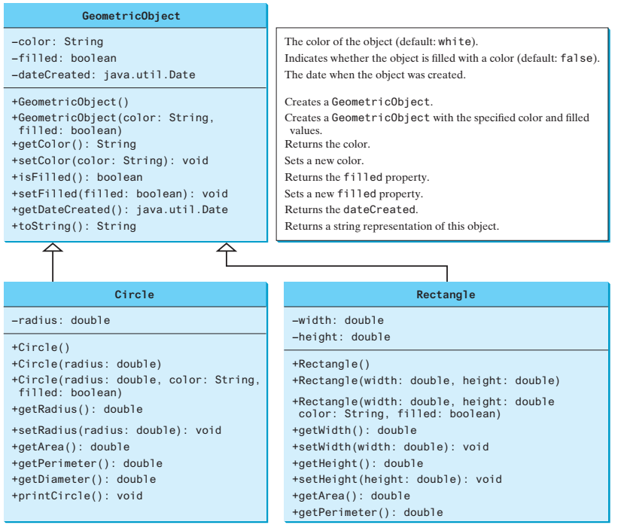
Abstract Classes: Introduction
Shape
Shape is a superclass
Models the common features of objects.
Circle and Rectangle are subclasses
Have their own properties.
Contain getArea() and getPerimeter()
#Shape()
#Shape(color:String, filled:boolean)
All shape objects need to compute areas and perimeters.
It is better to define the getArea() and getPerimeter() methods in the Shape class
??

Slide 9

Abstract Classes: Introduction
Shape
getArea() and getPerimeter() can not be implemented in the Shape class. Why?
#Shape()
#Shape(color:String, filled:boolean)
Their implementation depends on the specific type of shape object.
They are abstract methods

Slide 10
Abstract Classes: Introduction
We cannot provide a reasonable implementation of getArea() in the superclass.
We have to know whether the object is circle or rectangle.
It is better to define the getArea() and getPerimeter() methods in the Shape class. (common behavior).
So, we declare getArea() as an abstract method in the superclass because it has no implementation.
We enforce each subclass to override the geatArea() method.
Furthermore, we declare the Shape class to be an abstract class.

Slide 11
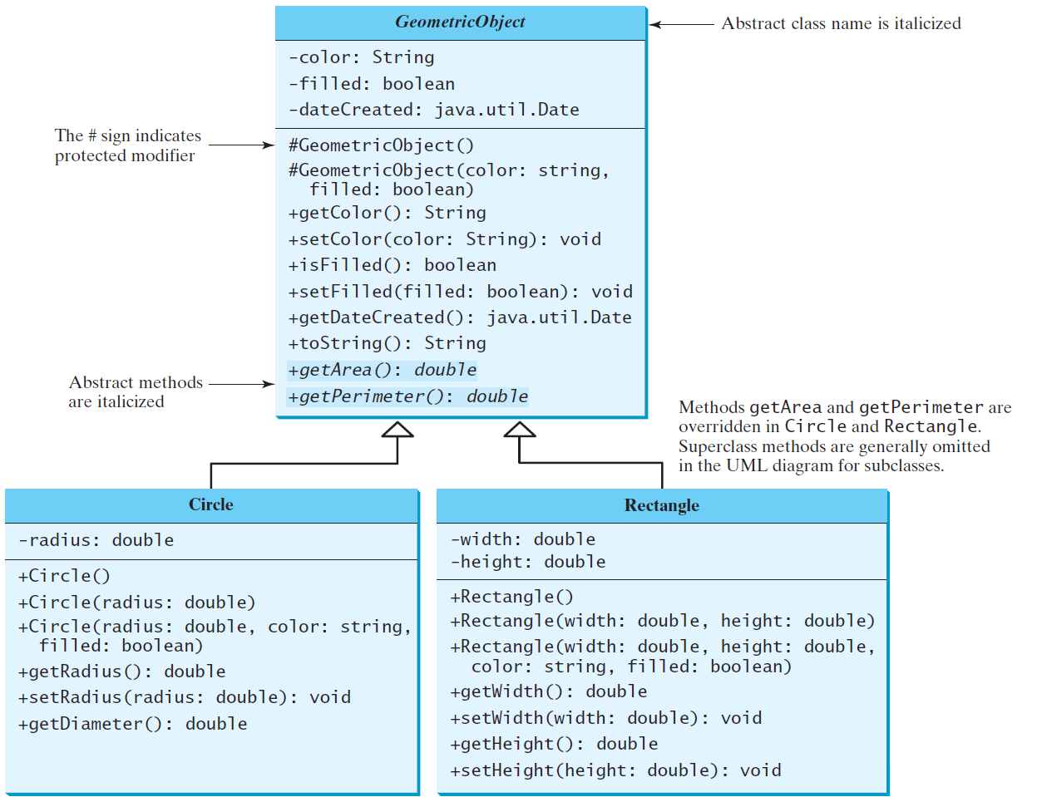
Abstract Classes: Example(1)
Shape
#Shape()
#Shape(color:String, filled:boolean)

Slide 12
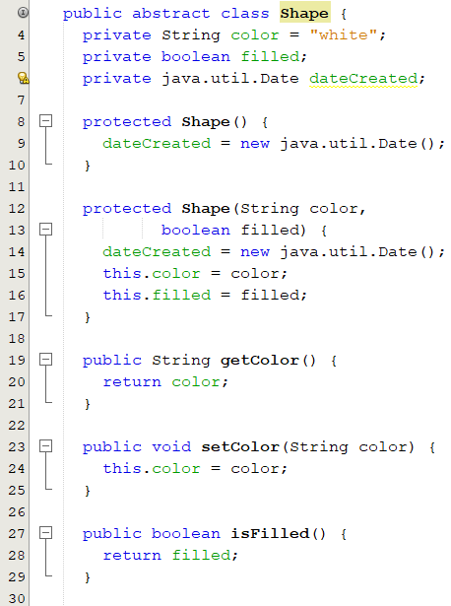
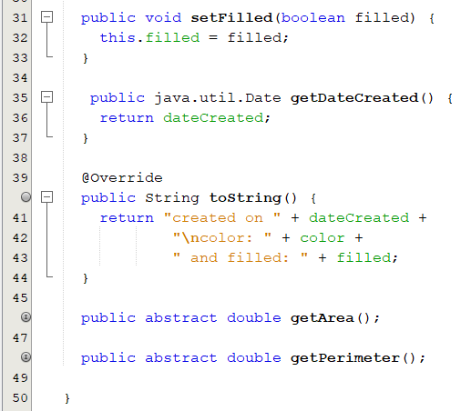
Abstract Classes: Example(1) - GeometricObject class
Abstract methods
?
Notes:
The constructor in the abstract class is defined as protected because it is used only by subclasses. When you create an instance of a concrete subclass, its superclass’s constructor is invoked to initialize data fields defined in the superclass.
The GeometricObject abstract class defines the common features (data and methods) for geometric objects and provides appropriate constructors.
Because you don’t know how to compute areas and perimeters of geometric objects, getArea() and getPerimeter() are defined as abstract methods.
These methods are implemented in the subclasses the computation of area and perimeter for each of these shapes is different, the subclasses should be forced to override these methods

Slide 13
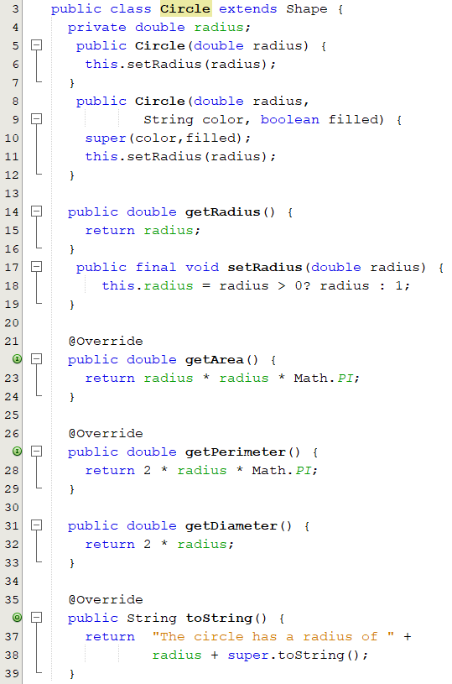
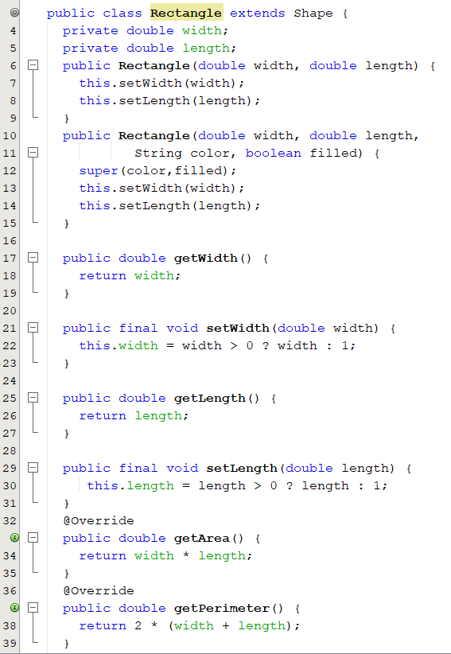
Abstract Classes: Example(1) - Circle and Rectangle Classes
Overridden abstract methods

Slide 14
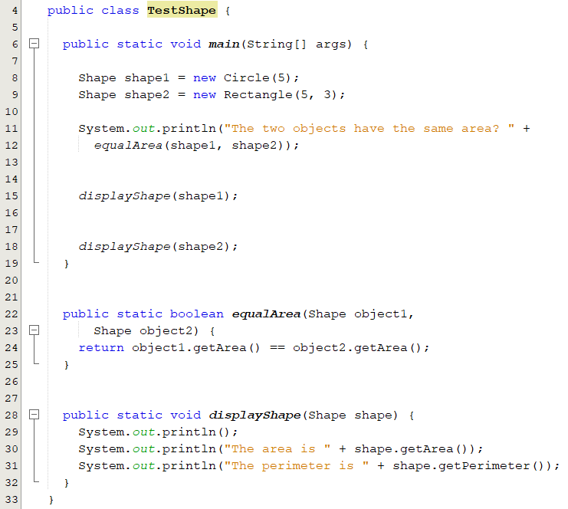
Abstract Classes: Example(1) - Test Class
shape1 is a circle
shape2 is a rectangle
Methods invoked based on the object type not the reference type.
Methods used based on the reference type not the object type.
Shape is a type.
Notes:
The statements (lines 5–6)
GeometricObject geoObject1 = new Circle(5);
GeometricObject geoObject2 = new Rectangle(5, 3);
create a new circle and rectangle and assign them to the variables geoObject1 and
geoObject2. These two variables are of the GeometricObject type
when invoking displayGeometricObject(geoObject1) (line 12), the methods getArea() and getPerimeter() defined in the Circle class are used, and when invoking displayGeometricObject(geoObject2) (line 15), the methods getArea and getPerimeter defined in the Rectangle class are used. The JVM dynamically determines which of these methods to invoke at runtime, depending on the actual object that invokes the method.

Slide 15
Abstract Methods (1/2)
Has a heading preceded by the modifier abstract.
Has no method body.
Ends with a semicolon in place of its body.
Will be implemented in the subclasses.
It cannot be private, Why?
The body of the method is defined in the derived classes:
Overridden in the subclasses.
Because of late binding, a method can be written in a superclass to perform a task, even if portions of that task aren't yet defined. (abstract method)
public abstract boolean equalArea();
public abstract boolean equalArea(){}
X
Notes:
An abstract method is like a placeholder for a method that will be fully defined in a descendent class

Slide 16
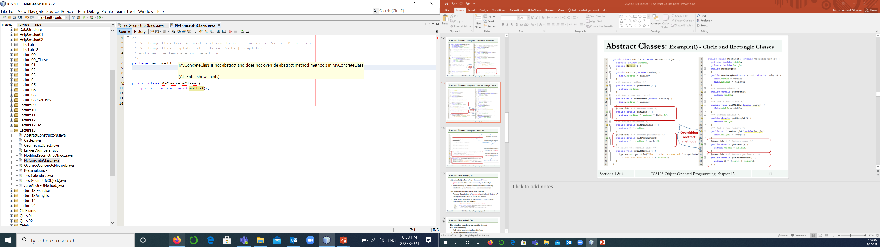
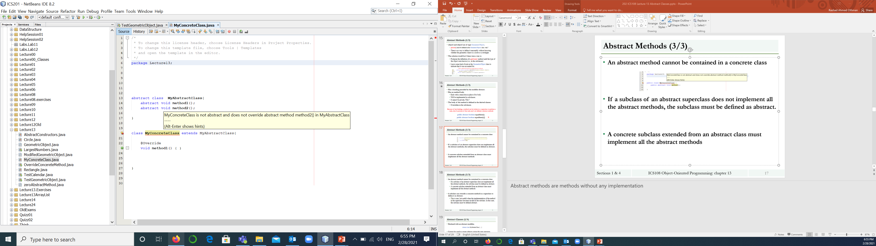
Abstract Methods (2/2)
An abstract method cannot be contained in a concrete class
If a subclass of an abstract superclass does not implement all the abstract methods, the subclass must be defined as abstract.
A concrete subclass extended from an abstract class must implement all the abstract methods
MyConcreteClass should be declared abstract
MyConcreteClass should override method2
Notes:
Abstract methods are methods without any implementation

Slide 17
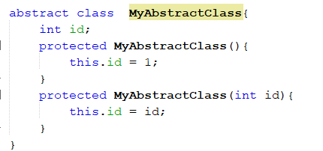
Abstract Classes (1/3)
Declared with an abstract modifier.
Cannot be used to create objects using the new operator.
Can have constructors
Must be protected.!?
Invoked in the subclasses.
abstract class MyAbstractClass {}
MyAbstractClass object = new MyAbstractClass();
X
MyAbstractClass[] objects = new MyAbstractClass[10];
√
Notes:
An abstract class must have the modifier abstract included in its class heading:
You cannot create an instance from an abstract class using the new operator, but an abstract class can be used as a data type. Therefore, the following statement, which creates an array whose elements are of GeometricObject type, is correct.
GeometricObject[] geo = new GeometricObject[10];
This makes it possible to plug in an object of any of its descendent classes
It is also fine to use a variable of an abstract class type, as long is it names objects of its concrete descendent classes only

Slide 18
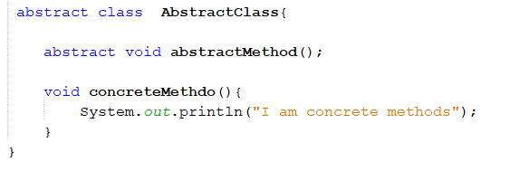
Abstract Classes (2/3)
Has non-abstract and abstract methods
Can be defined without abstract methods.
This class is used as a base class for defining new subclasses.
Abstract method
concrete method
Notes:
An abstract class can have any number of abstract and/or fully defined methods.
A class that has abstract methods is called a concrete class.

Slide 19
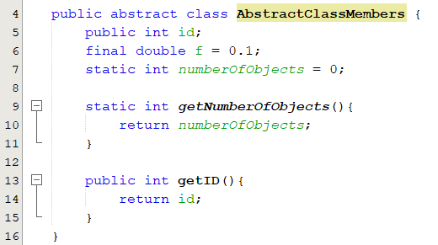
Abstract Classes (3/3)
Can have instance, final and static members
Can be used as a type
class subClass extends AbstractClass{}
AbstractClass[] objects = new AbstractClass[10];
AbstractClass object = new subClass();
Notes:
An abstract class constructor cannot be used to create an object of the abstract class
a derived class constructor will include an invocation of the abstract class constructor in the form of super

Slide 20
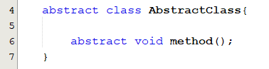
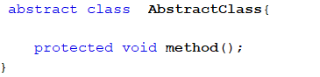
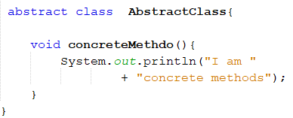
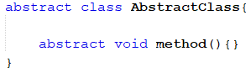
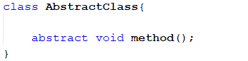
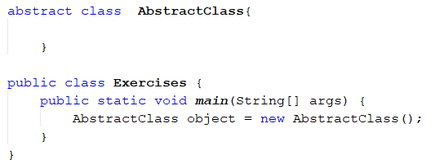
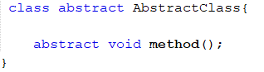
Popup-Question(1)
Which of the following legal and illegal?
A
B
C
D
E
F
G
H
AbstractClass[] object = new AbstractClass[5];

Slide 21
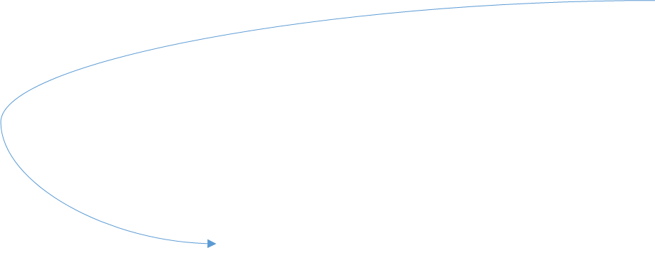
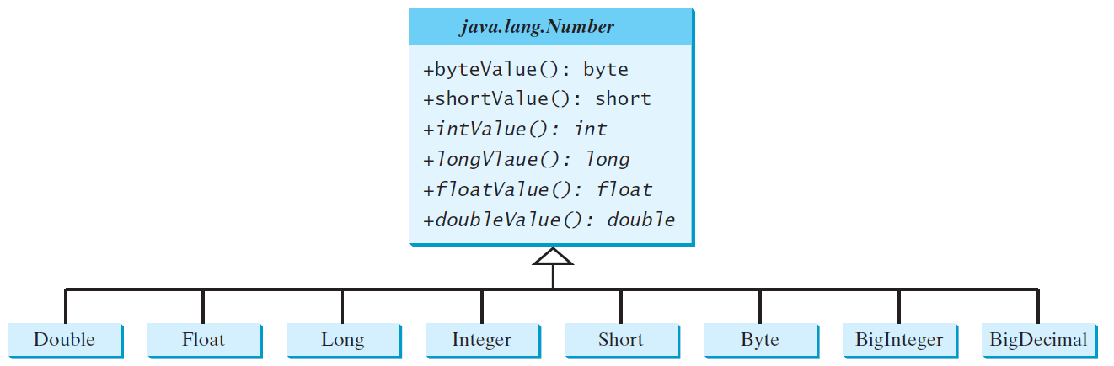
Case Study 1: The Abstract Number Class
The Abstract Number Class
Abstract superclass for numeric wrapper classes.
These classes have common methods for numbers
Can they be implemented in the Number class?
Why is it abstract?
java.lang.Number
+byteValue(): byte +shortValue(): short +intValue(): int +longValue(): long +floatValue(): float +doubleValue()
Returns this number as a byte. Returns this number as a short. Returns this number as an int. Returns this number as a long. Returns this number as a float. Returns this number as a double.
The Number class has no method called compareTo()
It has a method called equals
Double
Float
Long
Integer
Short
Byte
BigInteger
BigDecimal
Notes:
Number is an abstract superclass for numeric wrapper classes such as Double, Float, Long, Integer, Short, Byte, BigInteger, and BigDecimal.
Since the intValue(), longValue(), floatValue(), and doubleValue() methods cannot be implemented in the Number class, they are defined as abstract methods in the Number class.
The Number class is therefore an abstract class With Number defined as the superclass for the numeric classes, we can define methods to perform common operations for numbers

Slide 22
Case Study 1: Wrapper Classes
Java uses primitive types, such as int and char, for performance reasons.
Java provides an immutable Wrapper class for each of the primitive types.
All these classes are in the java.lang package.
A Wrapper class:
A class which contains the primitive data types (int, char, short, byte, etc).
Provide a way to use primitive data types (int, char, short, byte, etc) as objects.
Why do we need wrapper classes
Objects are needed if it is desirable to modify the arguments passed into a method

Slide 23
Case Study 1: Wrapper Classes
Primitive Type | Wrapper Class | Wrapper Class Constructors
byte | Byte | Byte(byte), Byte(String)
int | Integer | Integer(int), Integer(String)
long | Long | Long(long), Long(String)
short | Short | Short(short), Short(string)
float | Float | Float(float), Float(double), Float(String)
double | Double | Double(double), Double(String)
boolean | Boolean | Boolean(boolean), Boolean(String)
char | Character | Character(char)
The wrapper classes do not have no-arg constructors

Slide 24
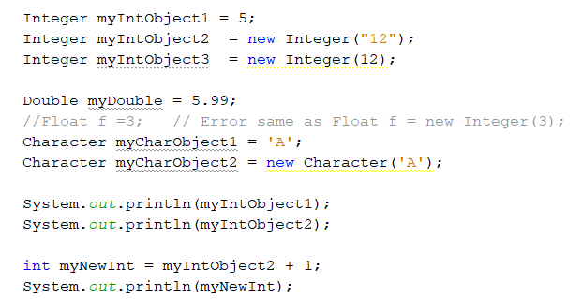
Case Study 1: Wrapper Classes Objects
WrapperClass variableName = value
WrapperClass variableName = new WrapperClass(value);
java.lang.NumberFormatException is thrown, if the arguments cannot be converted to a valid number of the corresponding primitive type
Integer myInt = new Integer(“6.12");
// creates Integer object with value 5
// creates Integer object with value 12

Slide 25
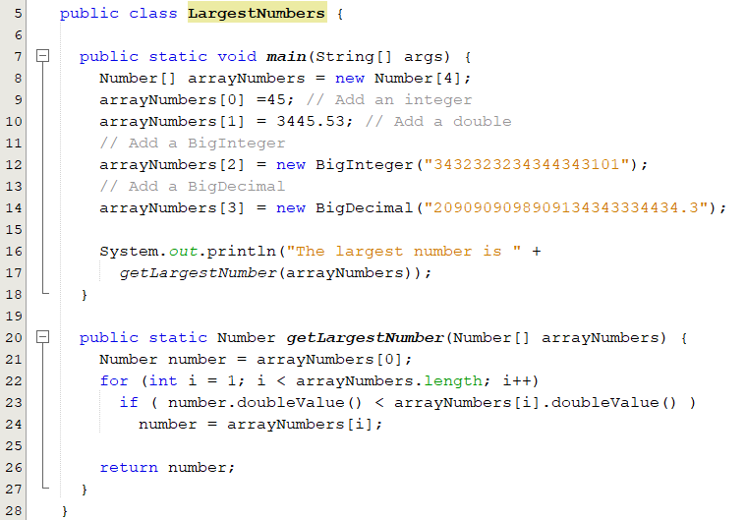
Case Study 1: Example

Slide 26
Interfaces

Slide 27


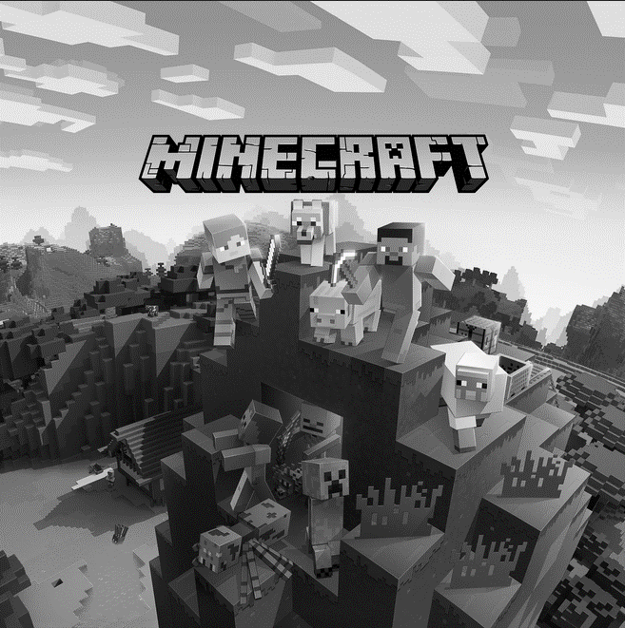


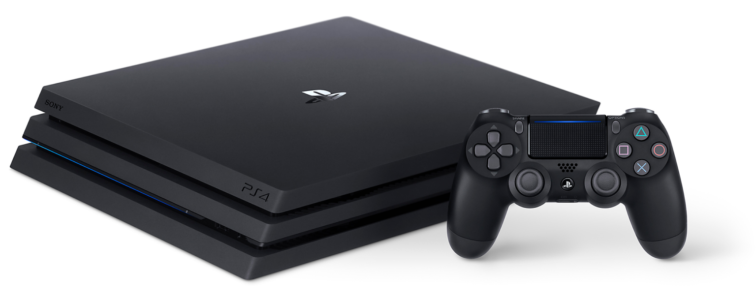
Introduction
A button on the gaming console performs different actions in each game.
Notes:
Welcome back.
In this lecture, let's try to understand about a very important concept in Java programming called Interface.
A number of students find it difficult to understand the difference between an abstract class and an interface. Syntactically both of them are almost the same. But from the usage perspective, how they are used, interfaces are very different.
So, what we are doing in this step is trying to give you a little bit of thought process in how you can think about interfaces.
right. Now, let's look at the picture what you are seeing on the screen right now is a gaming console. Right.
So, in there, whatever buttons that are present in here is the interface that is present to the game, right.
So, whatever game you're playing would actually implement something for each of these buttons.
So, when you press this button, what should happen? That is what the Games would implement.
Let's say you are playing a Mario game or a Chess game, these games provide implementations to the different things which are present on this interface.
And that's exactly how you would need to start thinking about interfaces in Java or for that matter.

Slide 28
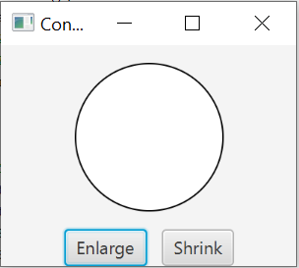
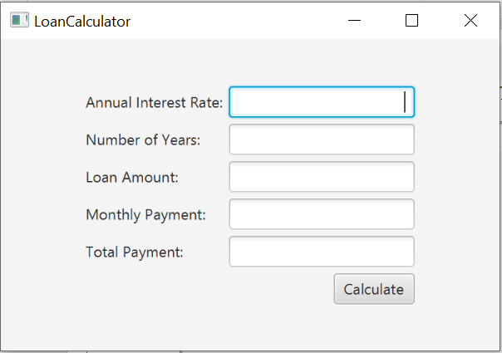
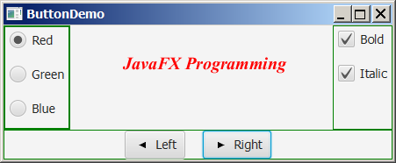
Motivation(1)
With GUI, write a code segment o respond to user actions, such as clicking a button to perform an action?

Slide 29
Motivation(2)
Inheritance allows code reusability.
Java allows only single inheritance.
A
method(int)
√
Does not support multiple inheritance.
A conflict can occur when a class implement multiple classes.
Same variables or methods with same names.
Multiple inheritance can be achieved through interfaces.
C
B
A
B
method(int)
method(int)
C
X
Notes:
1.Assume that A and B are overriding an inherited method and they provide their own implementation.
2. Now C inherits from both A and B doing multiple inheritance. C should inherit that overridden method.
3. which overridden method will be used?

Slide 30
Objectives
To understand interfaces and their prosperities.
To specify common behavior for objects using interfaces (§13.5).
To define interfaces and define classes that implement interfaces (§13.5).
To define a natural order using the Comparable interface (§13.6).
To make objects cloneable using the Cloneable interface (§13.7).
To explore the similarities and differences among concrete classes, abstract classes, and interfaces (§13.8).
To design classes that follow the class-design guidelines(§13.10).

Slide 31
Interface Definition
Java uses the following syntax to define an interface
Example
public interface InterfaceName {
//constant declarations;
//abstract method headers;
}
public interface Edible {
/** Describe how to eat */
public abstract String howToEat();
}

Slide 32
What is an interface?
A class-like construct
Contains only constants and abstract methods.
No constructors.
No instance variables.
Its intent is to specify common behavior for objects of related classes or unrelated classes.
Interface names are often adjectives.
Comparable, runnable
The relationship between the class and the interface is known as interface inheritance.
Notes:
An interface is something like an extreme case of an abstract class: However, an interface is not a class
It is a type that can be referred by any class that implements the interface

Slide 33
Similarity between Interfaces and Classes
Like a regular class
Each interface is compiled into a separate bytecode file.
Like an abstract class
You cannot instantiate an object from an interface using the new operator.
Declare methods that a child class must override.
Can be used as a data type for a reference variable
A reference variable of an interface type can reference any instance of the class that implements the interface.

Slide 34
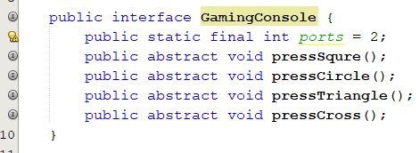
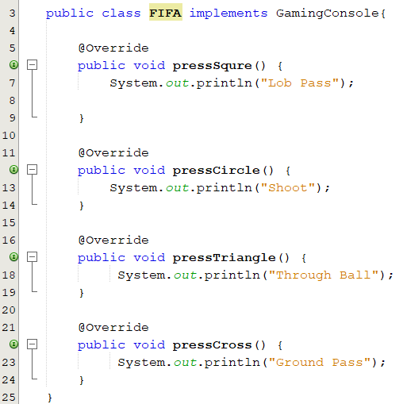
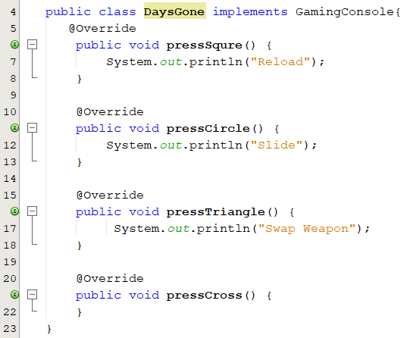
Interfaces: Example(1)
OUT OF THE BOOK
Notes:
The interface definition shows the heading only for several methods. Because only the headings are shown, they are considered abstract methods.
Each actual method with its body must
be defined in a class that implements the interface. Therefore, a class that implements this
interface must provide a void method called square.
The keywords public abstract are optional (and usually omitted) in an interface because all interface methods are public abstract by default

Slide 35
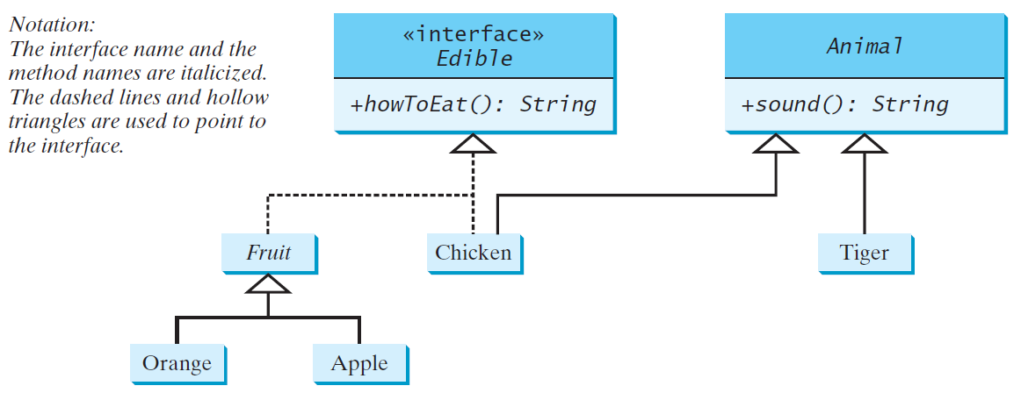
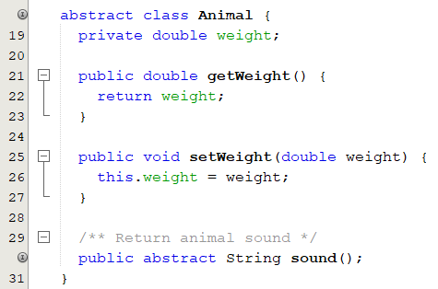
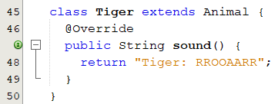
Interfaces: Example(2)
public interface Edible {
//Describe how to eat
public abstract String howToEat();
}

Slide 36
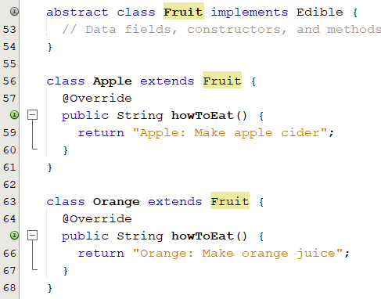
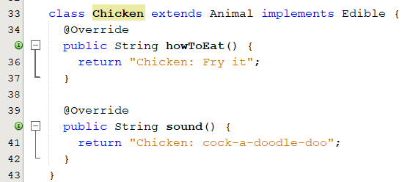
Interfaces: Example(2)
public interface Edible {
//Describe how to eat
public abstract String howToEat();
}

Slide 37
Modifiers in Interfaces
Data Fields
always
public final static
Can be omitted
Methods
always
public abstract
public interface T { public static final int SEED = 1; public abstract void method();
}
public interface T { int SEED = 1; void method();
}
Methods must be defined public when they are implemented in subclasses
Can be accessed
Constants
InterfaceName.CONSTANT_NAME
Notes:
All data fields are public final static and all methods are public abstract in an interface. For this reason, these modifiers can be omitted, as shown below:
Although the public modifier may be omitted for a method defined in the interface, the method must be defined public when it is implemented in a subclass.

Slide 38
Extending an Interface
You can define an interface based on another interface.
public interface Nameable { void setName(String petName); String getName(); }
public interface Capable { void hear();
String respond();
}
public interface Callable extends Nameable { void come(String petName); }
public interface Trainable extends Callable, Capable {
void sit();
String speak();
void lieDown();
}
Notes:
Once you have an interface, you can define another interface that builds on, or extends, the first one by using a kind of inheritance. Thus, you can create an interface that consists of the methods in an existing interface plus some new methods

Slide 39
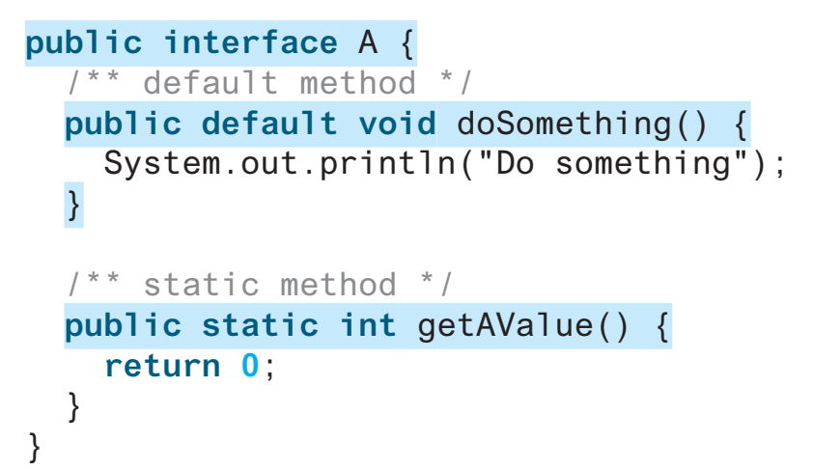
Default and Static Methods
Java 8 introduced default interface methods using the keyword default.
provides a default implementation for the method in the interface
Default Methods
A class that implements the interface
Static Methods
Uses the default implementation
Overrides the default implementation
Why default methods were added?
Backward compatibility
What would happen if we add a NEW METHOD in an existing interface.?
Notes:
The default implementation has special use and does not affect the intention behind interfaces. Suppose we need to add a new function in an existing interface. Obviously the old code will not work as the classes have not implemented those new functions. So with the help of default implementation, we will give a default body for the newly added functions. Then the old codes will still work.

Slide 40
Popup-Question(1)
Which of the following is a correct interface?
interface A{
void method();
}
interface A{
public static SEED = 1;
void method();
}
interface A{
void method(){}
}
interface A{
abstract void method();
}
interface A{
private void method();
}
interface A{
final void method();
}

Slide 41
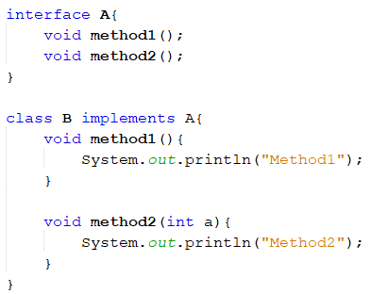
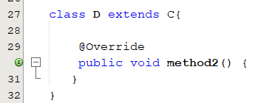
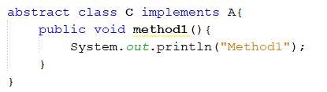
Popup-Question(2)
Show the errors in the following code?
Method1 in class B should be public.
Class B does not override method2.
Since Class C is abstract class, it is not necessary that it overrides all the abstract methods in the implemented interface.
However, C’s subclasses must override them if C does not override them.

Slide 42
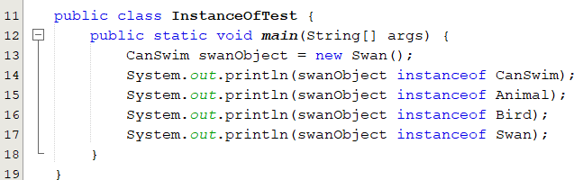
Popup-Question(3):
Given the following declaration, what is the output of the code below;
public interface CanSwim {}
public class Animal {}
public class Bird extends Animal {}
public class Swan extends Bird implements CanSwim {}
Bird swanObject = new Swan();

Slide 43
The Comparable Interface(1)
Defined in java.lang package.
Defines the compareTo method for comparing objects.
Find the larger of two objects of the same type.
E: generic type
Replaced by concrete type
public interface Comparable<E> {
public int compareTo(E obj);
}
-1: this object less than obj
0: this object equal obj
1: this object greater than obj
Notes:
Suppose you want to design a generic method to find the larger of two objects of the same type, such as two students, two dates, two circles, two rectangles, or two squares.
In order to accomplish this, the two objects must be comparable, so the common behavior for the objects must be comparable.
Java provides the Comparable interface for this purpose. The interface is defined as follows
The compareTo method determines the order of this object with the specified object o and returns a negative integer, zero, or a positive integer if this object is less than, equal to, or greater than obj
The Comparable interface is a generic interface. The generic type E is replaced by a concrete type when implementing this interface.

Slide 44
The Comparable Interface(2)
Many classes in the Java library implement Comparable to define a natural order for objects:
Integer, Long, Float, Double, String and Date.
public final class Integer extends Number implements Comparable<Integer> {
@Override
public int compareTo(Integer obj) {
// Implementation omitted
}
}
public final class String extends Object implements Comparable<String> {
@Override
public int compareTo(String obj) {
// Implementation omitted
}
}
Let n be an Integer object, s be a String object
n instanceof Integer
n instanceof Number
n instanceof Object
n instanceof Comparable
Integer n = new Integer(5);
System.out.println(new Integer(3).compareTo(n));
System.out.println("ABC".compareTo("ABE"));
java.util.Date date1 = new java.util.Date(2013, 1, 1);
java.util.Date date2 = new java.util.Date(2012, 1, 1);
System.out.println(date1.compareTo(date2));
s instanceof String
s instanceof Object
s instanceof Comparable
Notes:
Suppose you want to design a generic method to find the larger of two objects of the same type, such as two students, two dates, two circles, two rectangles, or two squares.
In order to accomplish this, the two objects must be comparable, so the common behavior for the objects must be comparable.
Java provides the Comparable interface for this purpose. The interface is defined as follows
The compareTo method determines the order of this object with the specified object o and returns a negative integer, zero, or a positive integer if this object is less than, equal to, or greater than obj
The Comparable interface is a generic interface. The generic type E is replaced by a concrete type when implementing this interface.

Slide 45
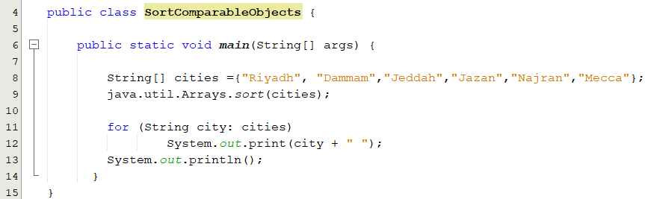
Generic sort Method
Provided the objects are instances of the Comparable interface
java.util.Arrays. sort(Object[]) method in the Java API uses the compareTo method to compare and sorts the objects in an array.
Notes:
Suppose you want to design a generic method to find the larger of two objects of the same type, such as two students, two dates, two circles, two rectangles, or two squares.
In order to accomplish this, the two objects must be comparable, so the common behavior for the objects must be comparable.
Java provides the Comparable interface for this purpose. The interface is defined as follows
The compareTo method determines the order of this object with the specified object o and returns a negative integer, zero, or a positive integer if this object is less than, equal to, or greater than obj
The Comparable interface is a generic interface. The generic type E is replaced by a concrete type when implementing this interface.

Slide 46
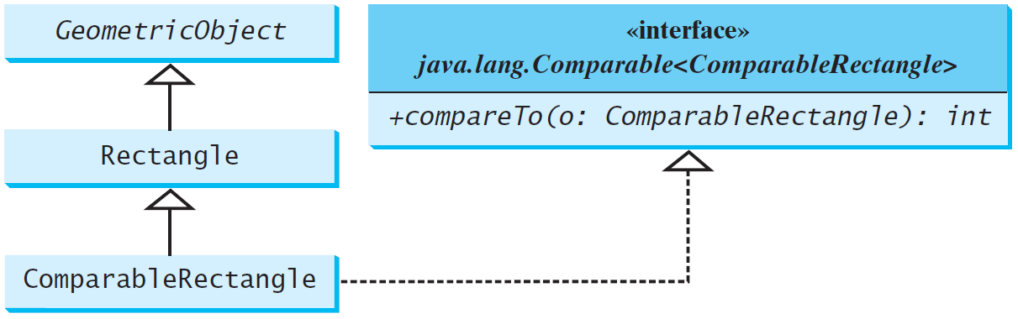
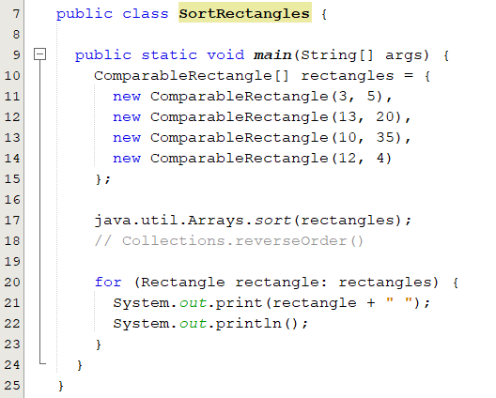
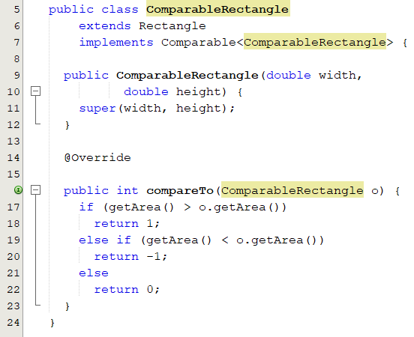
Defining Classes to Implement Comparable
If we don’t implements Comparable<ComparableRectangle>, we can not use java.util.Arrays.sort(rectangles);
Notes:
Suppose you want to design a generic method to find the larger of two objects of the same type, such as two students, two dates, two circles, two rectangles, or two squares.
In order to accomplish this, the two objects must be comparable, so the common behavior for the objects must be comparable.
Java provides the Comparable interface for this purpose. The interface is defined as follows
The compareTo method determines the order of this object with the specified object o and returns a negative integer, zero, or a positive integer if this object is less than, equal to, or greater than obj
The Comparable interface is a generic interface. The generic type E is replaced by a concrete type when implementing this interface.

Slide 47
The Comparator Interface
Sometimes you want to compare elements of different types. However, the elements may not be instances of Comparable or are not comparable.
To do so, define a class that implements the Comparator interface.
The Comparator interface has the compare method for comparing two objects.
public int compare(T element1, T element2)
Returns
a negative value if element1 is less than element2
a positive value if element1 is greater than element2
zero if they are equal.

Slide 48
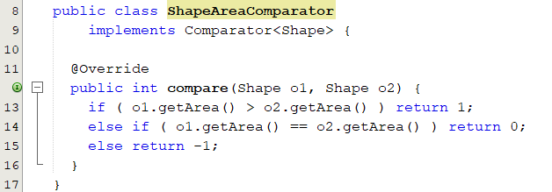
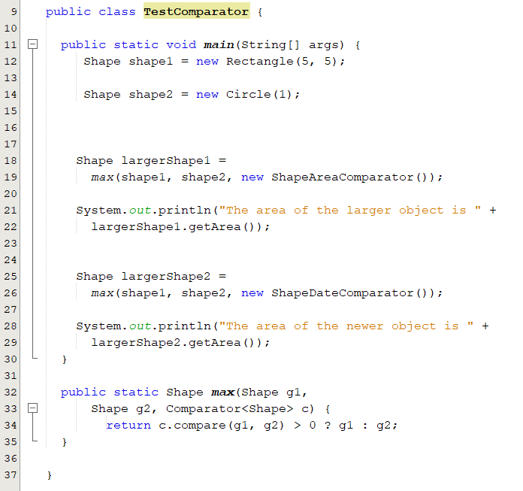
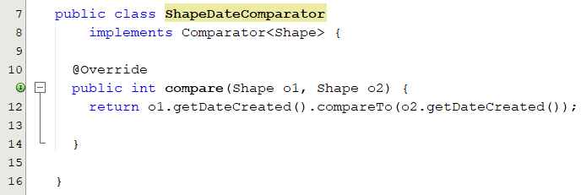
The Comparator Interface: Example 1
The area of the larger object is 25.0
The area of the newer object is 3.141592653589793

Slide 49
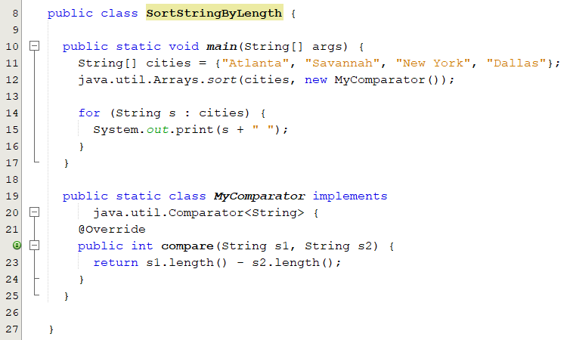
The Comparator Interface: Example 2

Slide 50
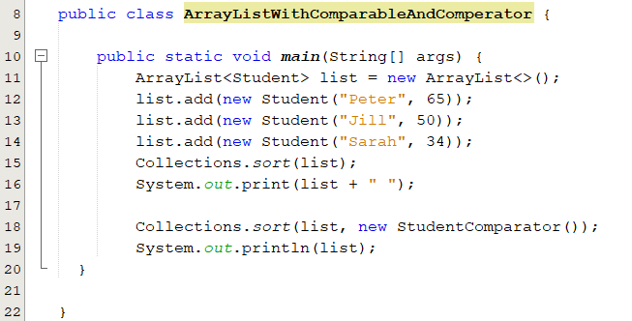

The Comparator and Comparable Interfaces: Example
Sorting students based on their ages using comparable interface and based on their names using comparator interface.

Slide 51
The Cloneable Interface(1)
Defined in java.lang package.
Defines the clone method for copying objects.
Create a copy of an object.
public interface Cloneable {
}
Empty
A marker interface
If a class implements the Cloneable interface
and overrides the clone() method defined in the Object class
It can be cloned using the clone() method defined in the Object class
Notes:
Often, it is desirable to create a copy of an object. To do this, you need to use the clone method and understand the Cloneable interface. An interface contains constants and abstract methods, but the Cloneable interface is a special case. The Cloneable interface in the java.lang package is defined as follows:
Marker interface is an interface which is empty, i.e. it does not contain any methods or fields. It is also known as a tagging interface and is used to indicate or inform the JVM that a class implementing this interface will have some special behaviour. An efficient way to classify code can be achieved using the marker interface. Examples of such an interface are: Serializable, Cloneable and Remote Interface.

Slide 52
Examples
Many classes (e.g., Date and Calendar) in the Java library implement Cloneable. Thus, the instances of these classes can be cloned. For example, the following code
Calendar calendar = new GregorianCalendar(2003, 2, 1);
Calendar calendarCopy = (Calendar) calendar.clone();
System.out.println(calendar == calendarCopy));
System.out.println(calendar.equals(calendarCopy));
Output:
false
true
int[] list1 = {1, 2};
int[] list2 = list1.clone();
list1[0] = 7;
list2[1] = 8;
System.out.println("list1 is " + list1[0] + ", " + list1[1]);
System.out.println("list2 is " + list2[0] + ", " + list2[1]);
Output:
list1 is 7, 2
list2 is 1, 8

Slide 53
The Clone Method
Not written in Java.
Implemented in the JVM for the native platform.
Can be accessed in the same package or in a subclass.
Must be overridden.
Its visibility modifier must be changed to public.
Throws CloneNotSupportedException if the object is not of type Cloneable.
The header for the clone method
protected native Object clone() throws CloneNotSupportedException;
Notes:
The keyword native indicates that this method is not written in Java, but is implemented in the JVM for the native platform.
The keyword protected restricts the method to be accessed in the same package or in a subclass.
For this reason, the class the implement Cloneable interface must override the method and change the visibility modifier to public so the method can be used in any package
The clone method defined in the Object class throws CloneNotSupportedException if the object is not a type of Cloneable.

Slide 54


The Cloneable Interface: Example
Notes:
The House class implements the compareTo method (lines 36–43) defined in the Comparable interface. The method compares the areas of two houses.

Slide 55


Shallow vs. Deep Copy
House house1 = new House(1, 1750.50);
House house2 = house1.clone();
Is house1 == house2 ?
Is house1. whenBuilt == house2. whenBuilt ?
Shallow Copy
Deep Copy
Notes:
The clone method in the Object class copies each field from the original object to the target object.
If the field is of a primitive type, its value is copied. For example, the value of area (double type) is copied from house1 to house2.
If the field is of an object, the reference of the field is copied.
For example, the field whenBuilt is of the Date class, so its reference is copied into house2, as shown in Figure a. Therefore, house1.whenBuilt == house2.whenBuilt is true.
although house1 == house2 is false.
This is referred to as a shallow copy rather than a deep copy, meaning if the field is of an object type, the object’s reference is copied rather than its contents.

Slide 56


Shallow vs. Deep Copy: Implementation
Shallow Copy
Deep Copy
What is the output of the following code given the two definition of the clone method above?

Slide 57




Implementing Multiple Interfaces
Classes are allowed to implement multiple interfaces
A conflict can occur
Due to either same constant variable or a method with same signature.
Methods with same signature and same return type
√
The interfaces have the same constant
Methods with same signature and different return type
❌
❌

Slide 58
Comparison of Concrete Classes, Abstract Classes, and Interfaces
Property | Concrete Class | Abstract Class | Interface
Can be instantiated | Yes | No | No
Constructors | Yes | Yes | No
Instance/Static variables | Yes | Yes | No
Constants | Yes | Yes | Yes
Instance Methods | Yes | Yes | Yes
Static methods | Yes | Yes | No (Yes Java 8)
Abstract methods | No | Yes | Yes
Extend another class | Yes (1) | Yes (1) | No
Implement other interfaces | Yes | Yes | No
Extend other interfaces | No | No | Yes
Used as a type | Yes | Yes | Yes

Slide 59
Class-Design Guidelines: Encapsulation
Each class can present two contracts:
One for the users of the class.
One for the extenders of the class.
Make the fields private and accessor methods public if they are intended for the users of the class.
Make the fields or method protected if they are intended for extenders of the class.
Provide a setter method only if you want the data field to be updateable.
A class should also hide methods not intended for client use.

Slide 60
Class-Design Guidelines: Instance vs. Static
A variable that is shared by all instances of a class should be declared static.
e.g. numberOfObjects in Circle
A method that is not dependent on a specific instance should be defined as a static method.
Reference static variables and methods using a class name.
It is better to use a setter method to change the static data fields.
Do not pass a parameter from a constructor to initialize a static data field.

Slide 61
Class-Design Guidelines: Clarity and Reuse
Class should have a clear contract that is easy to explain and easy to understand.
Design a class that imposes no restrictions on how or when the user can use it.
Do not declare a data field that can be derived from other data fields.
Date of birth and age.
Provide a public no-arg constructor and override the equals method and the toString method defined in the Object class whenever possible.

Slide 62
Class-Design Guidelines: Cohesion
A class should describe a single entity.
All the class operations should logically fit together to
Support a coherent purpose.
Example: Student, Staff
Separating responsibilities
A single entity with too many responsibilities can be broken into several classes to separate responsibilities
String: immutable.
StringBuilder: mutable.
StringBuffer: serve concurrency.

Slide 63
Class-Design Guidelines:
Consistency
Follow standard Java programming style and naming conventions
Choose informative names.
Place the data declaration before the constructor, and place constructors before methods.
Make the names consistent.
Provide a public no-arg constructor. Otherwise document the reason.
Completeness
A class should provide a variety of ways for customization through properties and method to be useful in a wide range of applications.
List: addFisrt, addLast, InsertAt, etc…

Slide 64
Class-Design Guidelines:
Interfaces vs. Abstract Classes:
For a strong is-a relationship use abstract classes.
A weak is-a relationship can be modeled using interfaces.
String class implements the Comparable.
You can also use interfaces if multiple inheritance is desired.
Inheritance vs. Aggregation:
Use inheritance to model the is-a relationship
Student is a person.
Use aggregation to model has-a relationship
Student has an address.

